Slide 1
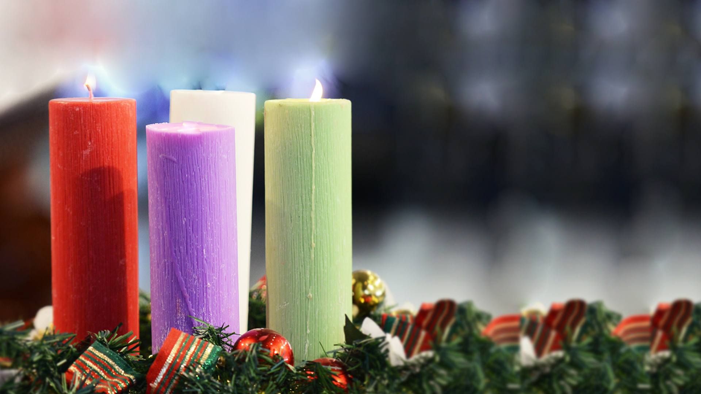
New Year’s Day 01/01/2020

Slide 2
Entrance

Slide 3
The angel Gabriel from heaven came His wings as drifted snow His eyes as flame "All hail" said he "thou lowly maiden Maaaaaaaaary Most highly favoured laaaady, " Gloooooooria

Slide 4
"For known a blessed mother thou shalt be All generations laud and hooonor thee Thy Son shall be Emanuel By seers foretold Most highly favoured

Slide 5
Then gentle Mary meekly bowed her head "To me be as it pleaseth God, " she said, "My soul shall laud and magnify His holy name" Most highly favoured

Slide 6
Of her, Emmanuel, the Christ was born In Bethlehem, all on a Christmas morn, And Christian folk throughout the word Will ever say

Slide 7
lady Glooooooooooria!

Slide 8
Penitential act

Slide 9
Lord have mercy Christ have mercy Lord have mercy, have mercy on us

Slide 10
Kyrie Eleison Christe Eleison Kyrie Eleison

Slide 11
Glory

Slide 12
Glory to God, glory to God, glory to God in the highest and on earth peace, and on earth peace, peace to people of good will

Slide 13
We praise You, we bless you We adore You, we glorify You We give you thanks for your great glory Lord God heavenly King, O God almighty Father

Slide 14
Lord Jesus Christ, only begotten Son Lord God Lamb of God, son of the Father You take away the sins of the world, have mercy on us You take away the sins of the world, receive our prayer

Slide 15
You are seated at the right hand of the Father, have mercy on us For You alone are the Holy One, You alone are the Lord You alone are the Most High, Jesus

Slide 16
Spirit In the glory of God the Father Amen, amen

Slide 17
Gospel Acclamation

Slide 18
Alleluia, a---lle-lui-a! Alleluia, a---lle-lui-a!

Slide 19
Any text here Other line with text

Slide 20
Alleluia, a---lle-lui-a! Alleluia, a---lle-lui-a!

Slide 21
Offertory

Slide 22
Once In Royal David s City chords H Gauntlett / C Alexander 1849

Slide 23
Once in royal David s city, stood a lowly cattle shed Where a mother laid her Baby, in a manger for His bed Mary was that mother mild, Jesus Christ, her little Child

Slide 24
He came down to earth from heaven, who is God and Lord of all And His shelter was a stable, and His cradle was a stall With the poor, and mean, and lowly, lived on earth our Savior holy

Slide 25
And, through all His wondrous childhood, he would honor and obey Love and watch the lowly maiden, in whose gentle arms He lay Christian children all must be, mild, obedient, good as He

Slide 26
For He is our childhood's pattern; day by day, like us, He grew He was little, weak, and helpless, tears and smiles, like us He knew And He cares when we are sad, and he shares when we are glad

Slide 27
And our eyes at last shall see Him, through His own redeeming love For that Child so dear and gentle, is our Lord in heaven above And He leads His children on, to the place where He is gone

Slide 28
Holy

Slide 29
Holy, holy, holy, holy Lord, holy Lord, holy Lord God of Hosts, Heaven and earth are full of your glory Hosanna in the highest Hosanna, hosanna, hosanna

Slide 30
Blessed, blessed, blessed, blessed is he who comes in the name, Who comes in the name of the Lord Hosanna, hosanna, hosanna in the highest Hosanna, hosanna, hosanna

Slide 31
Communion

Slide 32
Lamb of God you take away the sins of the world have mercy on us

Slide 33
Lamb of God you take away The sins of the world graaant us peace

Slide 34
Communion

Slide 35
Oh little town of Bethlehem How still we see thee lie Above the dark and dreamless sleep The silent stars go by

Slide 36
Yet in thy dark streets shineth The everlasting light The hopes and fears of all the years Are met in thee tonight

Slide 37
O morning stars together Proclaim thy holy birth And praises sing to God the King And peace to men on earth

Slide 38
For Christ is born of Mary And gathered all above While mortals sleep the angels keep Their watch over wondering love

Slide 39
How silently, how silently, The wondrous gift is given; So God imparts to human hearts The blessings of His Heaven

Slide 40
No ear may hear His coming, But in this world of sin, Where meek souls will receive Him still, The dear Christ enters in

Slide 41
Where children pure and happy Pray to the blessed Child Where misery cries out to thee Son of the mother mild

Slide 42
Where charity stands watching And faith holds wide the door The dark night waits the glory breaks And Christmas comes once more

Slide 43
Oh holy child of Bethlehem, Descend on us we pray; Cast out our sin and enter in Be born in us today

Slide 44
We hear the Christmas angels, Their great glad tidings tell, Oh come to us, abide in us, Our lord, Emanuel

Slide 45
Final

Slide 46
Angels we have heard on high, sweetly singing o‘re the plains And the mountains in reply, echoing their joyous strains

Slide 47
Gloria in excelsis Deo Gloria in excelsis Deeo

Slide 48
Come to Bethlehem and see, Christ whose birth the angels sing Come adore on bended knee, Christ the Lord the newborn

Slide 49
Gloria in excelsis Deo Gloria in excelsis Deeo

Slide 50
See Him in a manger laid, whom the choirs of angels praise Mary, Joseph, lend your aid, while our hearts in love we raise

Slide 51
Gloria in excelsis Deo Gloria in excelsis Deeo

